Slide 1

Centering Servingness in Research Development
LSC 241 4:00-5:00pm
Presenters:
Jeanine Bias, Chief Experience Officer
Jalon Berry, Assistant Director, Inclusion Initiatives

Slide 2

Centering Servingness in Research Development
Jeanine Bias
Chief Experience Officer
Jalon Berry
Assistant Director, Inclusion Initiatives

Slide 3
Objectives
Discuss the importance of “servingness” at Hispanic-Serving Institutions (HSIs)
Explore how HSI grants are beneficial to students and the institution
Share strategies for HSI Grant writing

Slide 4

Activity
Notes:
Define "servingness"

Slide 5
Servingness is a concept that Garcia, Núñez, and Sansone (2019) argue is a multidimensional and conceptual way to understand what it means to move from simply enrolling Latinx students to actually serving them.

Slide 6
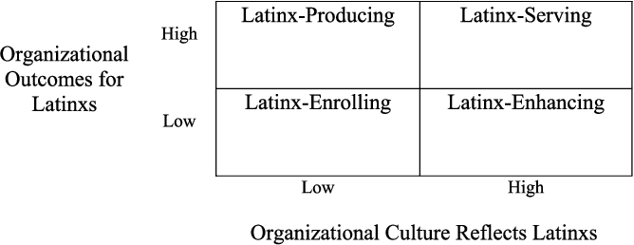

Slide 7

What does this mean?
Notes:
What does this mean
What does this not mean
Crucial role of grant funding in supporting research initiatives
Discuss the unique challenges and opportunities at HSIs

Slide 8
HSI Insight
In 2022, Sam Houston State University (SHSU) achieved designation from the Department of Education as a Hispanic Serving Institution (HSI).
A Hispanic-Serving Institution (HSI) is defined as an institution of higher education that—
is an eligible institution; and
has an enrollment of undergraduate full-time equivalent students that is at least 25 percent Hispanic students at the end of the award year immediately preceding the date of application.

Slide 9
U.S. Department of Education Hispanic-Serving Institutions Grant Programs
The U.S. Department of Education offers 3 discretionary grants to support Hispanic-Serving Institutions. The U.S. Department of Education’s Hispanic-Serving Institutions Division manages these grant programs.

Slide 10
Types of HSI Grants
Developing Hispanic-Serving Institutions (DHSI) Program
Hispanic-Serving Institutions – Science, Technology, Engineering, or Mathematics (HSI STEM) and Articulation Program
Promoting Postbaccalaureate Opportunities for Hispanic Americans (PPOHA) Program
Notes:
Dept. Of Education
NASA
USDA
NSF

Slide 11

Notes:
Emphasize the potential positive impact of servingness-oriented research on student success and retention.
Explain how servingness differs from traditional research approaches

Slide 12
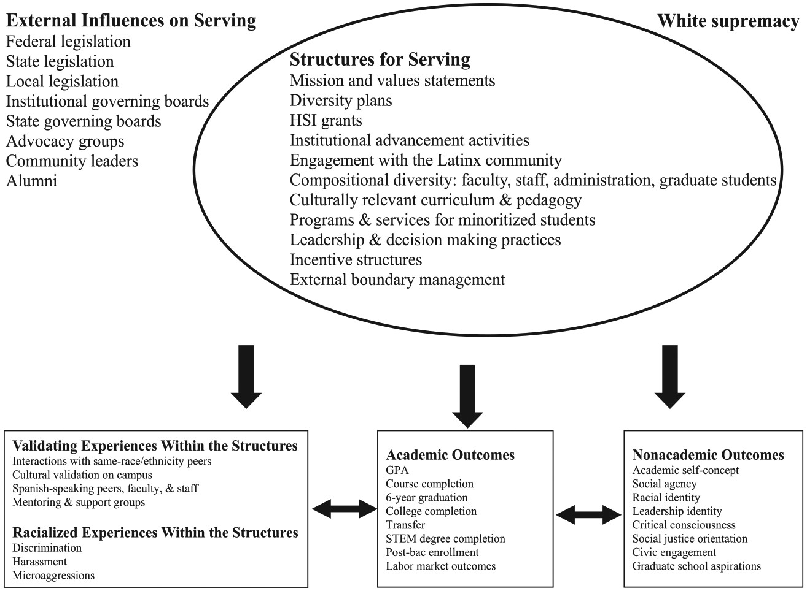

Slide 13

Why Servingness Matters at HSIs
Different from traditional research approaches
Positive impact on student success and retention

Slide 14

Through the Lens of…

Slide 15
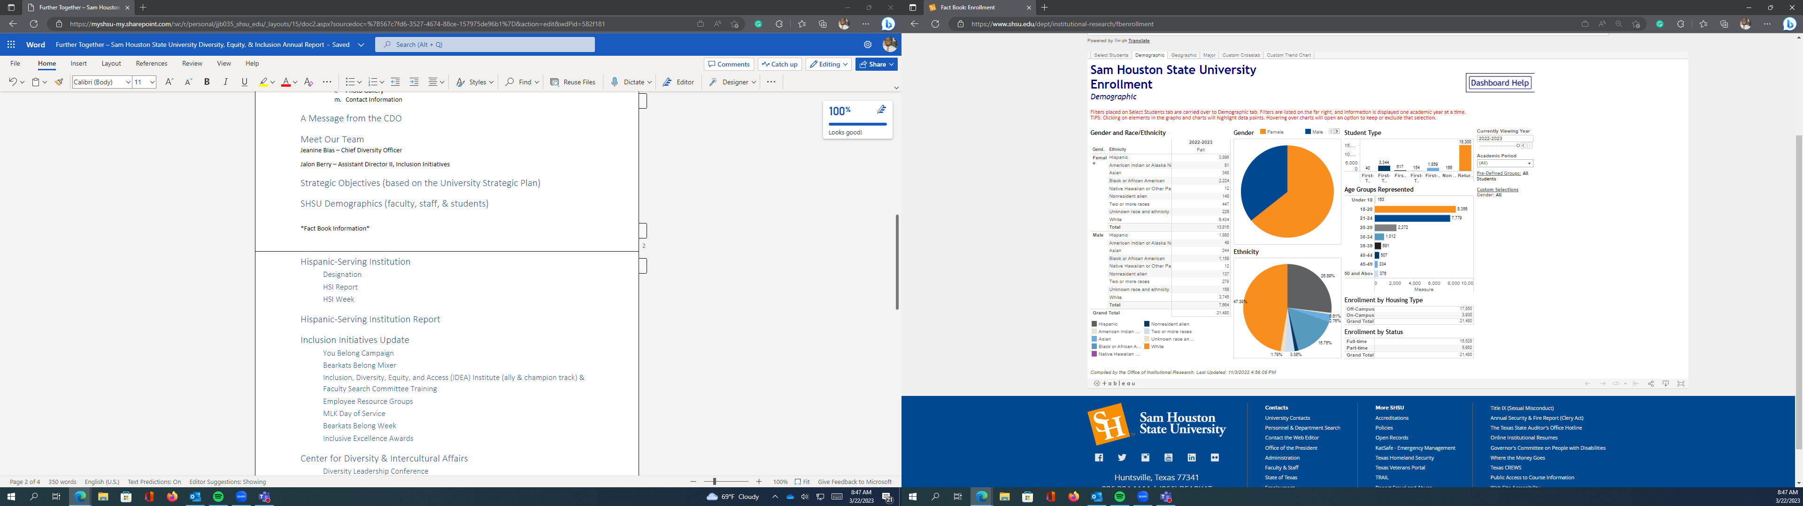

Slide 16

Through the lens of…
First Generation
Non-Traditional
Rural/Urban/Suburban
Pell-Eligible
Honors
LGBTQIA+
Students with Disabilities
Religious/Non-Religious
Students with Children
Students of Color
Legacy Students
Veterans
Online Students
Athletes
Classification
Transfer Students
International Students
Working Students
Minor/Early Start Students
No one left behind….
Notes:
Highlight the increasing importance of HSIs in serving underrepresented populations. Especially Hispanic Students.

Slide 17

Remember Service when Writing

Slide 18

Notes:
Due to the increase in HSIs, these grants are extremely competitive
Remember

Slide 19
Aligning the Research Priorities
SHSU Strategic Plan
1. Prioritize Student Success and Student Access
2. Embody a Culture of Excellence
3. Remember the values of SHSU:
  Student Success and Support
  Academic Excellence
  Service and Community Engagement
  Inclusive Excellence
  Collaborative Environment
  Honor
  Creativity and Innovation
U.S. Secretary of Education Priorities Raise the Bar: Lead the World
Breaking down barriers that impede the access of higher education institutions that serve Hispanic and Latino students, such as HSIs, to Federal funding, and strengthening the capacity of those institutions to participate in Federal programs and partnerships;
Advancing racial equity and economic opportunity by connecting education to labor market needs through programs such as dual enrollment, career and technical education, registered apprenticeships, work-based learning, and career advancement, particularly in the fields of science, technology, engineering, and mathematics; and
Ensuring that Hispanic and Latino communities have access to resources for economic success, such as in the areas of financial education, small business development, entrepreneurship, arts, science, technology, engineering, and mathematics.
*Remember the needs of our students and the institution
Notes:
Examples of how these can align in the grant writing process

Slide 20
Challenges & Things to Consider
Legislation
How will we sustain grant-funded efforts after the funding ends?
Limited Personnel
Limited Primary Investigators
Concurrent Title III and Title V grants
Building Capacity
Others

Slide 21

Solutions

Slide 22
Resources & Support
SHSU Services
Office of Research & Sponsored Programs
SHSU Experience Office
Professional Organizations
Hispanic Association of Colleges and Universities (HACU)
Excelencia in Education
Alliance of Hispanic Serving Institutions Educators (AHSIE)

Slide 23

Collaborative Partnerships (Internal)
Division of Academic Affairs
Division of Student Affairs
Division of Enrollment Success
The Graduate & Professional School
Services for Students with Disabilities
Veterans Resource Center
First-Generation Center
Programs for Underserved Students
Etc.
Academic Colleges

Slide 24

Collaborative Partnerships (External)
Local school districts
Community Colleges
Businesses
Etc.

Slide 25

Steps for Successful HSI Grant Writing

Slide 26
Putting the pieces together...
Before Grant Writing Begins
Identify current programs or research that can be scaled up
Research potential opportunities
Understand grant cycles
Read previously awarded grant proposals
Identify a team
Identify other stakeholders
Brainstorm ideas/create a template
Data collection
Starting the process
Read the grant thoroughly
Identify the key priorities of the grant
Does the grant indicate additional point opportunities?
During the process
Utilize resources and campus partners

Slide 27
Considerations
Large HSI grant proposals require strategic planning and communication between various units on campus early on in the process. Often, data collection about our underserved students and programs is required on these types of projects even before developing a proposal.
If you are considering or interested in writing a proposal for a large grant, you should be scheduling or participating in kickoff, planning, and writing meetings to ensure timelines are feasible for gathering information and determining roles and responsibilities on the project. This should occur at least six month ahead of time to prepare for large HSI proposals.
Additional stakeholders usually need to be involved in the proposal by providing letters of support or collaboration, administrative or training support, or serve as senior advisors or personnel on the project.
Large grants are INSTIUTIONAL GRANTS and should be collobrative

Slide 28

Other HSI/MSI Grant Opportunities to watch for...

Slide 29

Grant Opportunities
National Science Foundation
National Institutes of Science
Department of Agriculture
Department of Defense
Department of Health and Human Services
Department of Homeland Security
Department of Justice
Department of Energy
Department of Transportation

Slide 30
Servingness beyond the grant writing
Student Success
Sense of Belonging
Institutional Mission and Motto

Slide 31

Closing Remarks and Questions

